Slide 1


Platforms for Advanced Wireless Research
Abhimanyu Gosain
Technical Program Director
https://www.advancedwireless.org/
May 14, 2018

Slide 2
Today’s Agenda
Welcome & PAWR Overview
PAWR Awardees
  COSMOS
  POWDER
Where is GENI now ?
PAWR-GENI Synergy
What’s in it for You ?

Slide 3
Platforms for Advanced Wireless Research
1
1
2
Industry Consortium
<$ + In-Kind>
$50M
NSF
<$>
$50M

Slide 4
Level-Setting: PAWR Approach
Attribute |  | Approach
Problem Definition |  | Enhanced efforts of ~400 university researchers who need mid-scale testing capabilities to ensure success
Early Industry Involvement |  | Multi-use research platforms with “pre-competitive” research topic areas selected bottom-up by university PIs, with industry input
Research Scope |  | Mid-sized areas within cities, experimental platforms, 10-20 antenna sites, backhaul, SDRs
Flexibility and Speed |  | 1 - 2 platforms per year in years 1 and 2, followed by a 4th in year 3
Streamlined governance, deployment, and operation |  | One governance consortium focused on upfront research and policy; city/university teams propose how to streamline deployment and ops

Slide 5
Program Figures
$25M
Cash + In-Kind
Per Platform
4
City Scale Platforms
5
Years of Funding
Notes:
Cash + in-kind equipment and services
4 platforms ( upto 2 in first year)
5 years of funding after which sustainability of operation

Slide 6




















Charter Members
PPO is Looking for more Industry Partners….

Slide 7
PAWR Guiding Principles
Drivers for
success
Reproducibility
  Platforms setup, maintained, documented
  High scientific standards
  Accuracy and repeatability
Usability
  Low learning curve, even if “open”
  Operable by BS technical level
  Reprogrammed by Advanced Users
Interoperability
  Prevent silos within research ecosystem
  Well-defined interfaces
  Interconnection with other PAWR platforms
Programmability
  Programmable at multiple levels (e.g., radio, resource allocation, backbone)
  Clearly defined interfaces and APIs.
Open Access
  Accessible by the research community
  Fairness in access
Diversity
  Broad range of topics
  spectrum, mmWave, internet of things, wide-area wireless backhaul, measurements etc.

Slide 8

PAWR Awardees
http://powderwireless.net http://cosmos-lab.org

Slide 9




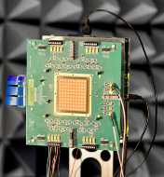
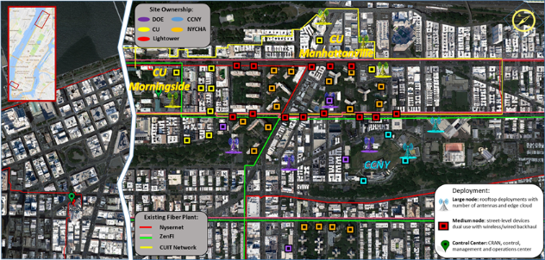
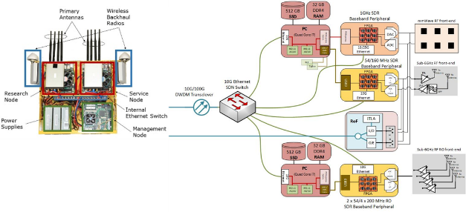
COSMOS:Cloud Enhanced Open Software Defined Mobile Wireless Testbed for City-Scale Deployment
A multi-layered computing system with an RF thin client; flexible signal processing; network function virtualization (NFV) between a local SDR (with FPGA assist) and a remote cloud radio access network (CRAN) with massive CPU/GPU and FPGA assist
Deployed in New York City, one of the country’s most populated urban centers
Wideband radio signal processing (with bandwidths of ~500 MHz or more)
Support for mmWave communication (28 and 60 GHz)
Optical switching technology (~1µs) provides passive WDM switch fabrics and
radio over fiber interfaces for ultra-low latency connections
28GHz phased-array ICs and phased-array antenna modules (PAAM)
Deployment Area: West Manhattan/Harlem
COSMOS Radio Site Design All-Optical Network Design

Slide 10



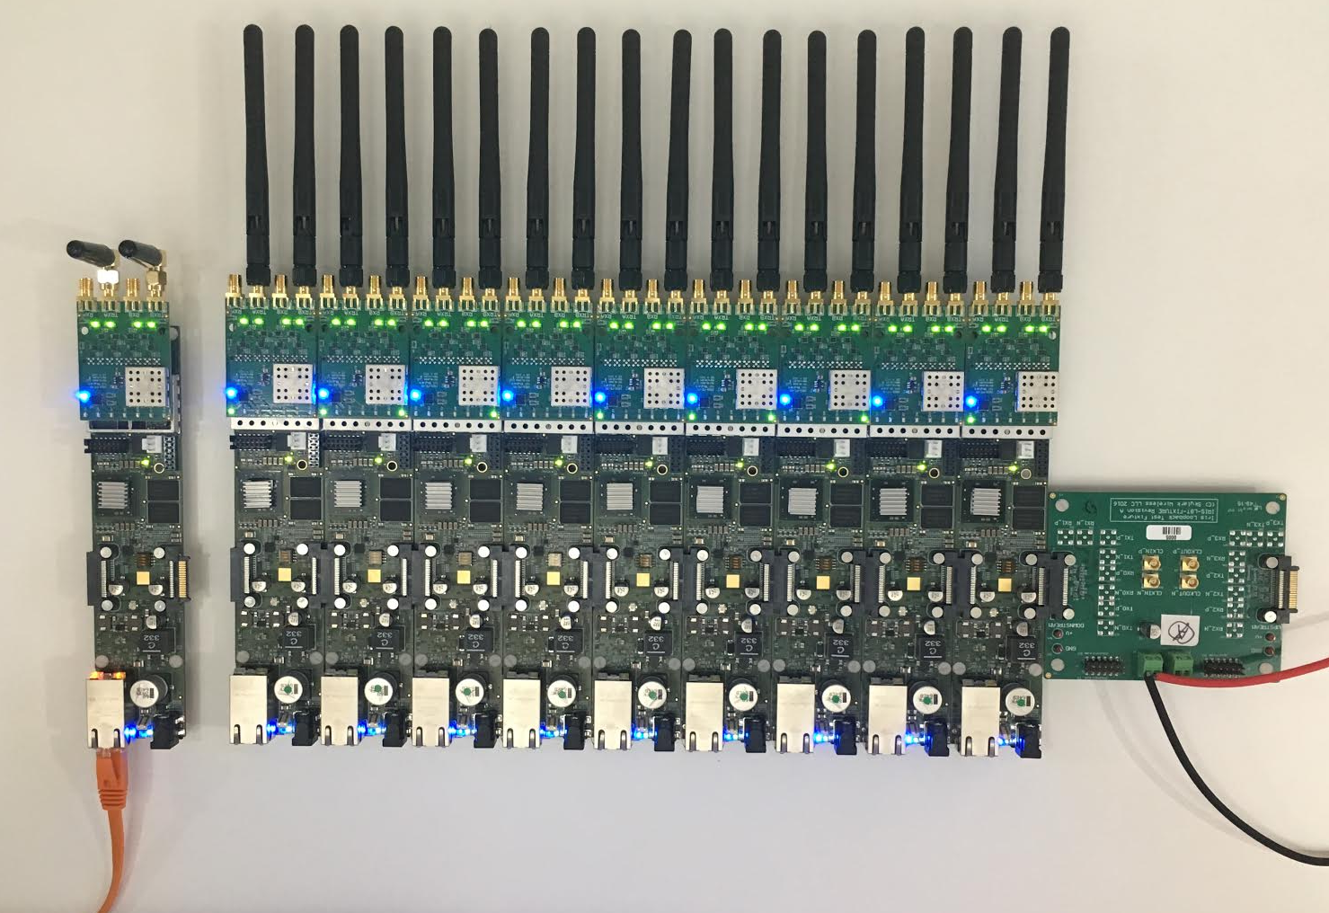
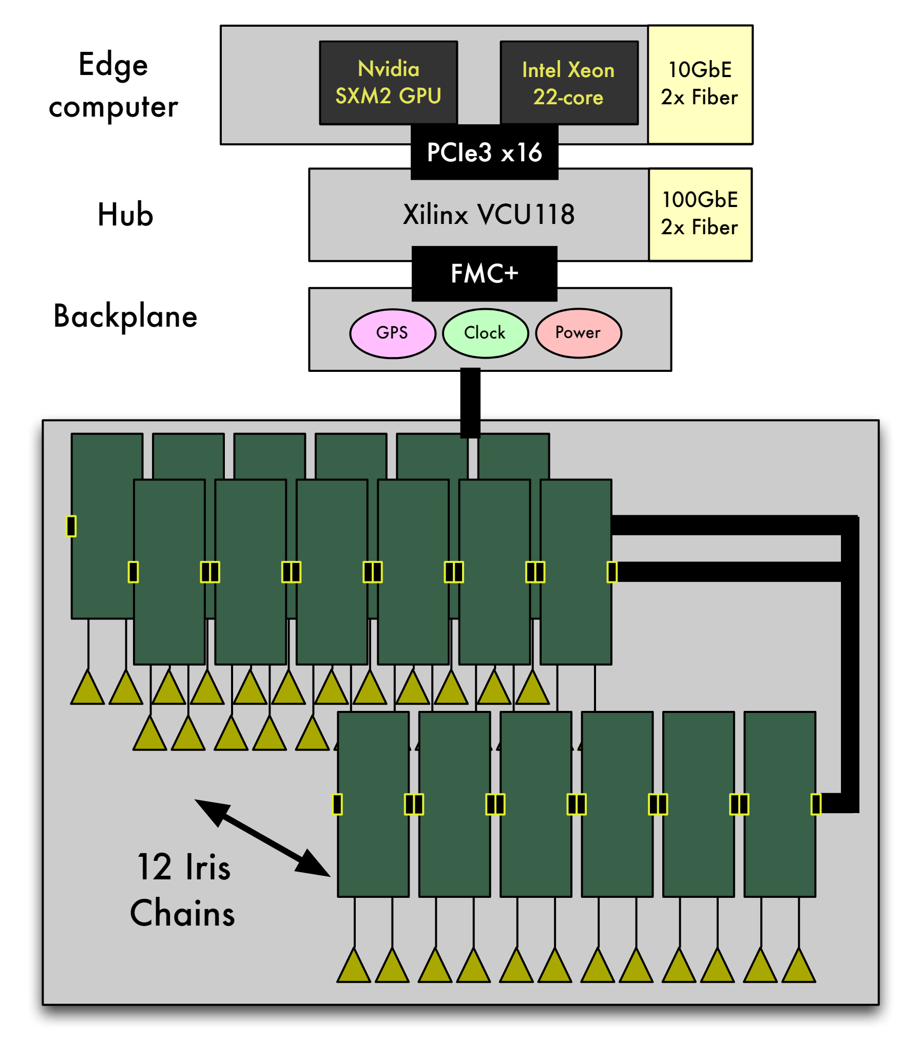
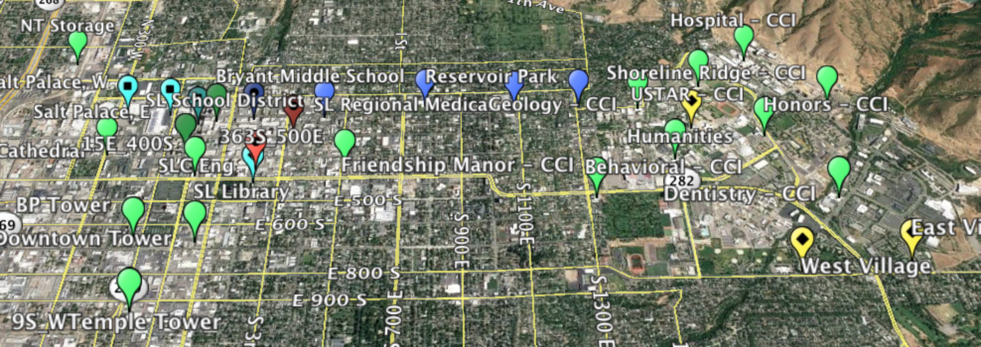
POWDER: Platform for Open Wireless Data-driven Experimental Research
RENEW: A Reconfigurable Eco-system for Next-generation End-to-end Wireless
Next Generation Wireless Architecture
Dynamic Spectrum Sharing
Distinct environments: a dense urban downtown and a hilly campus environment.
RENEW Massive MIMO base station
End-to-End Programmable
Diverse Spectrum Access 50 MHz-3.8GHz
Hybrid Edge computer composed of FPGA and GPU/CPU-based processing,
Hub Board aggregates/distributes streams of radio samples
Deployment Area: UofU Campus +Downtown SLC + Connected Corridor
IRIS software-defined radio modules
Control Framework with Hardware + Software Building Blocks
Architectural view of RENEW base station

Slide 11
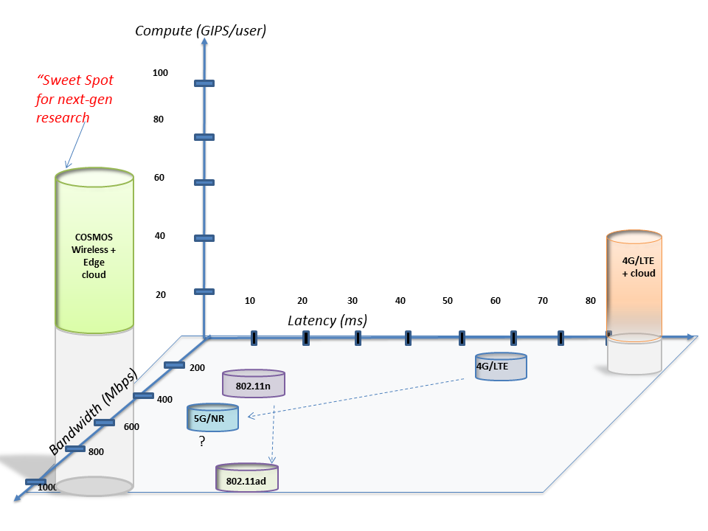
Project Vision
Latency and compute power are the two new dimensions for characterizing wireless access
Latency for 4G cellular > 50 ms, while targets for 5G are <10 ms
Edge computing is an enabler for real-time services
COSMOS will enable researchers to investigate ultra-high speed (~Gbps), low latency (<5ms), and edge computing (~10-100 GIPS)
COSMOS = Cloud Enhanced Open Software Defined Mobile Wireless Testbed for City-Scale Deployment

Slide 12

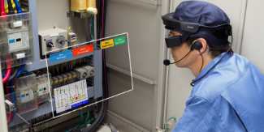




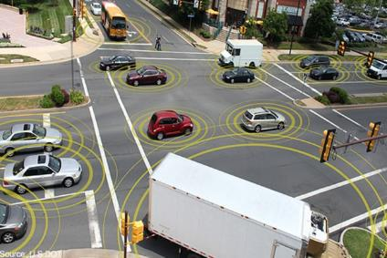

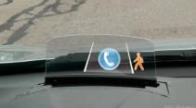
Project Vision
Ultra-high bandwidth, low latency, and powerful edge computing will enable important new classes of real time applications
Application domains include AR, VR, connected car, smart city (with high-bandwidth sensing), industrial control, …
Augmented Reality
Smart City + Connected Car
Image/
Video
Cloud
Infrastructure
Roadside
AP
Roadway sensors & lighting
In-car guidance display
Industrial Control

Slide 13
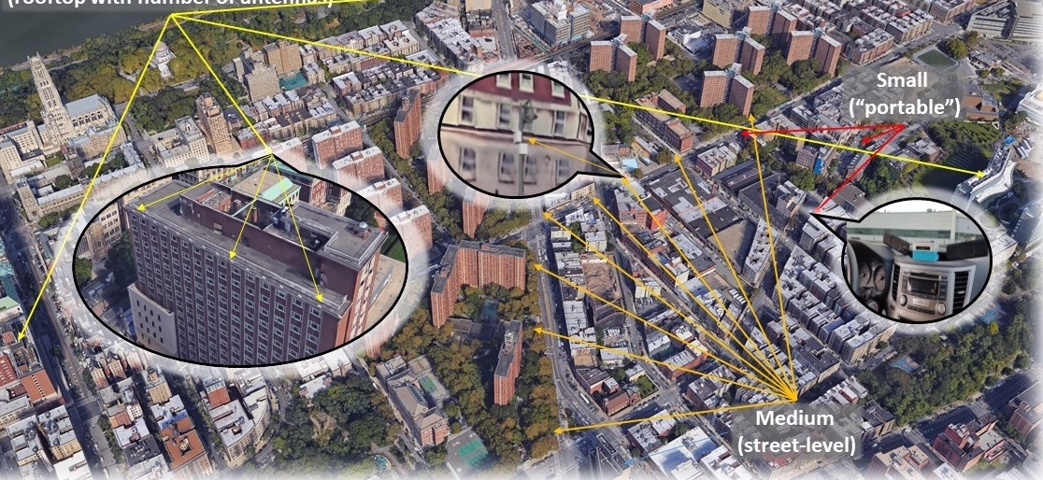
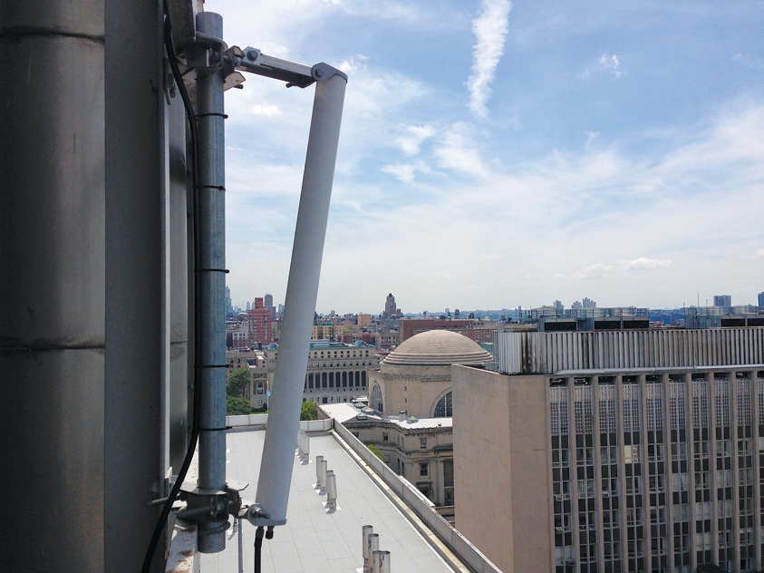
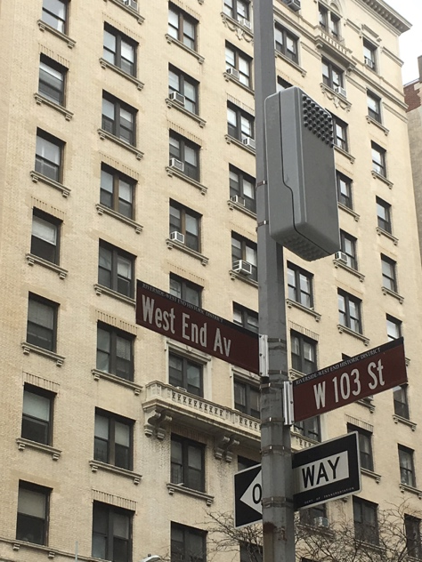
Planned Deployment
West Harlem
Area: ~1 sq. mile
~9 Large Sites ~40 Medium sites
Fiber optic connection from most sites
~200 Small nodes
  Including vehicular and hand-held
Fiber connection to NYU Data Center, Rutgers, GENI/I2
Interaction with smart community & innovation initiatives (Gigabit center, etc.)

Slide 14
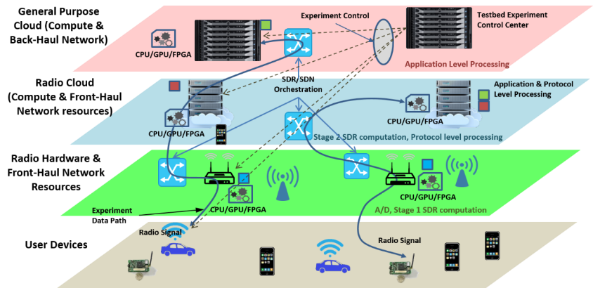
System Architecture
COSMOS architecture has been developed to realize ultra-high BW, low latency and tightly coupled edge computing
Key design challenge: Gbps performance + full programmability at the radio level
Developed a fully programmable multi-layered (i.e. radio, network and cloud) system architecture for flexible experimentation

Slide 15
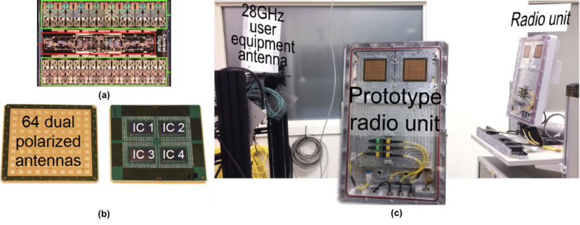
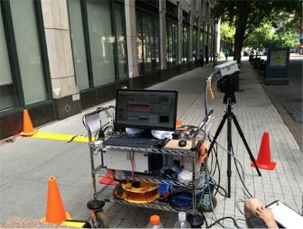
Key Technologies -mmWave
mmWave a key new technology for the testbed, with limited availability of components
Leveraging ongoing CU collaboration with IBM to provide mmWave phased arrays (64 antennas, 8 beams) for both 28 Ghz and 60 Ghz
Extensive mmWave systems expertise at NYU, including prototype systems and channel measurements
mmWave components from IBM
NYU Channel Measurements

Slide 16
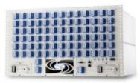
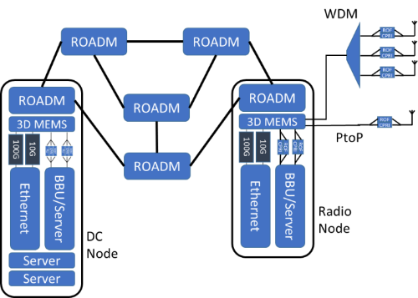
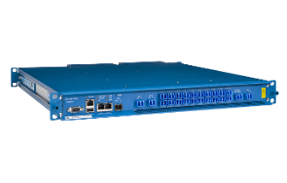

Key Technologies – Optical Net
MEMS Switch
Fast and low latency optical x-haul network using 3D MEMS switch and WDM ROADM
  Configure wide range of topologies
  Experiment on converged fiber/wireless networks
Enables fast front-haul/mid-haul/back-haul connectivity between radio nodes and edge cloud
SDN control plane for both optical and Ethernet switching
Leverages results from CIAN NSF ERC, EAGER dark fiber project at Columbia
ROADM (whitebox)

Slide 17
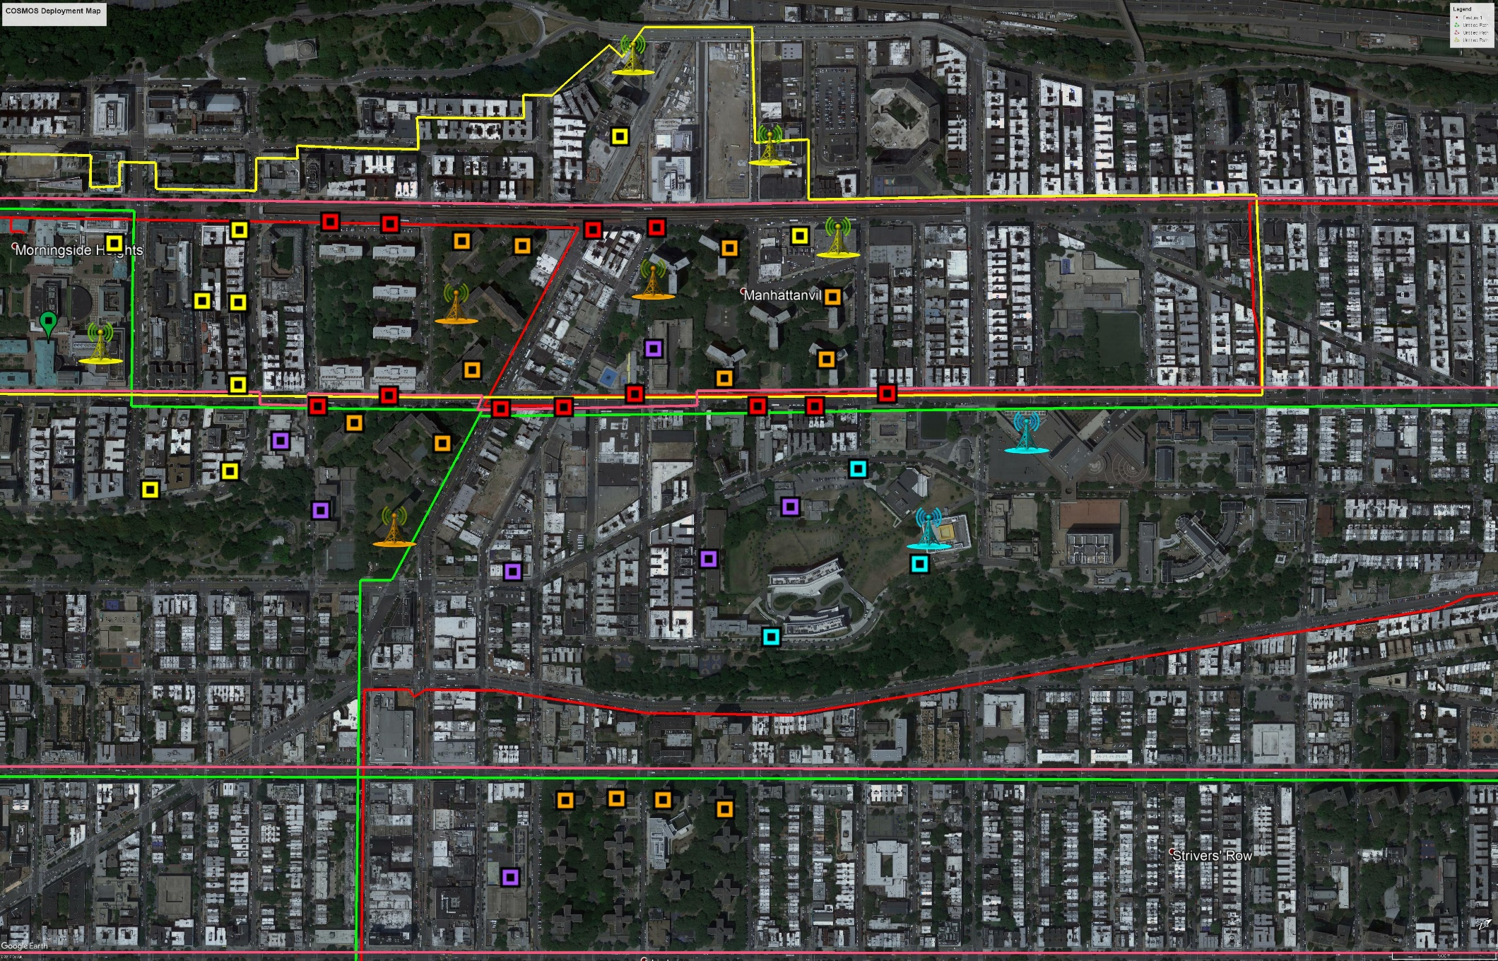





COSMOS: Deployment
Site Ownership:
DOE
CCNY
CU
NYCHA
Deployment:
Lightower
Large node: rooftop deployments with number of antennas and edge cloud
Existing Fiber Plant:
Nysernet
Medium node: street-level devices dual use with wireless/wired backhaul
ZenFi
CUIT Network
Control Center: CRAN, control, management and operations center

Slide 18

City scale living lab, for novices through experts, to enable repeatable research and fundamental advances in wireless technologies, services and applications

Slide 19
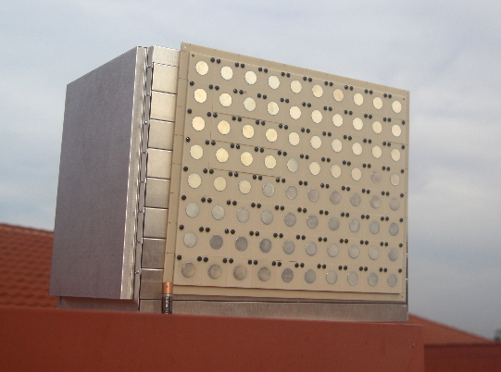
RENEW: Accelerating “World’s Firsts”
GOAL: Enable unforeseen community-driven “world’s firsts”
World’s first fully programmable & observable Massive MIMO network platform
Base-station class 3.5GHz (key 5G band), low-latency design
Capable of 50MHz – 3.8GHz
World’s first open-access complete networks stacks
Support cellular and WiFi standards as baseline
Foster next-generation ideas
Support end-to-end applications

Slide 20
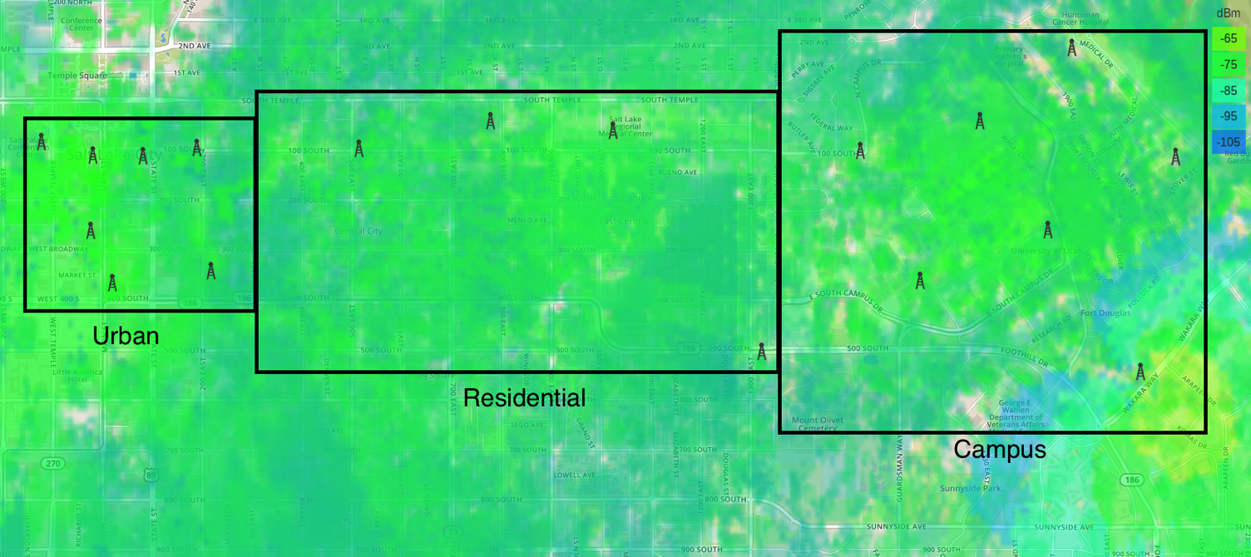
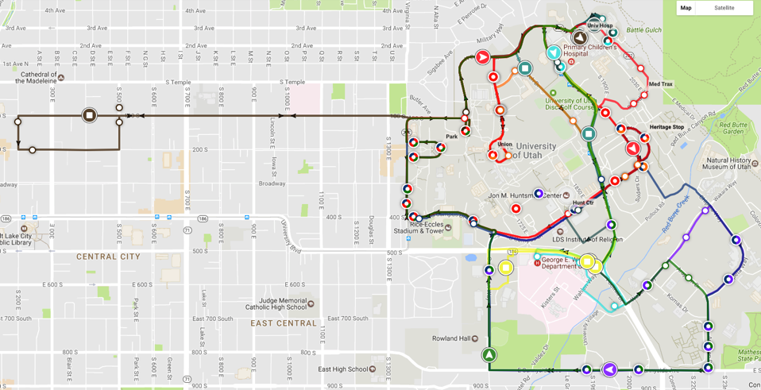
Coverage

Slide 21
Functional Infrastructure
Base functionality:
  End-to-end software defined
    Support broad range of research
  Building block approach with control framework
    next slide…
Extended functionality:
  Bring-your-own-device style research
    At all “layers” of the architecture

Slide 22
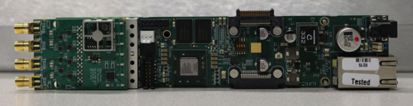
Off-the-shelf RF equipment

Slide 23

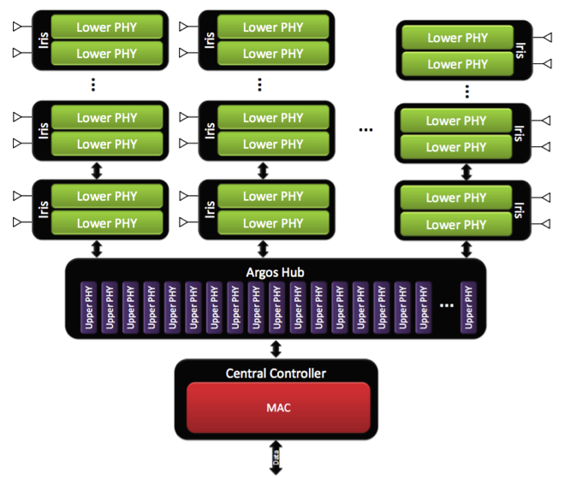
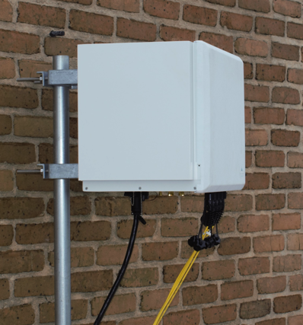
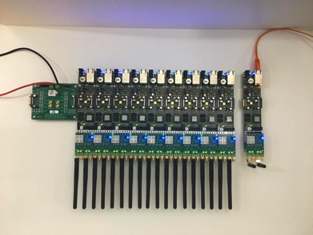
RENEW custom RF equipment
Programmable wide-band radios
Massive MIMO
Novel PHY and networking stacks

Slide 24
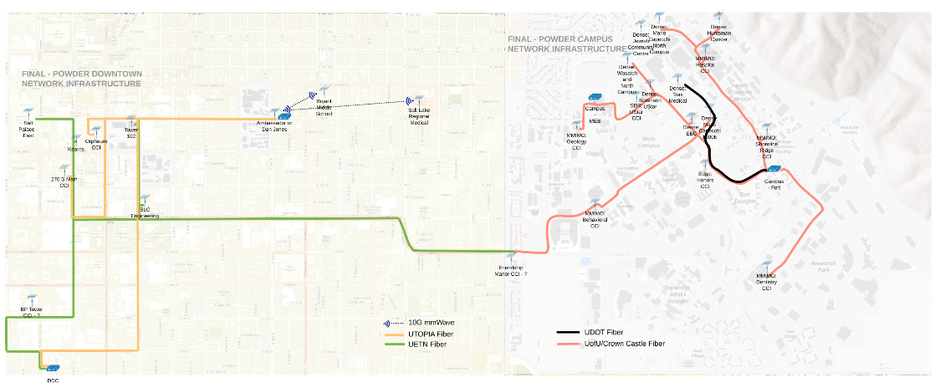

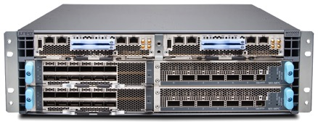
Backhaul network and near edge
100 Gbps private fiber network
Synchronous Ethernet (SyncE), Precision Time Protocol (PTP) support
Heavy duty compute/storage

Slide 25

Spectrum
Range (MHz)
698-806 | Commercial/Public Safety
902-928 | Industrial, scientific and medical (ISM)
1710-1755 | Extended Advanced Wireless Services (EAWS) uplink
2110-2155 | Extended Advanced Wireless Services (EAWS) downlink
3550-3650 | Citizens Broadband Service
5150-5925 | Unlicensed National Information Infrastructure (U-NII)
Broad range of frequencies
Program license/Innovation zone
Dynamic spectrum access system:

Slide 26

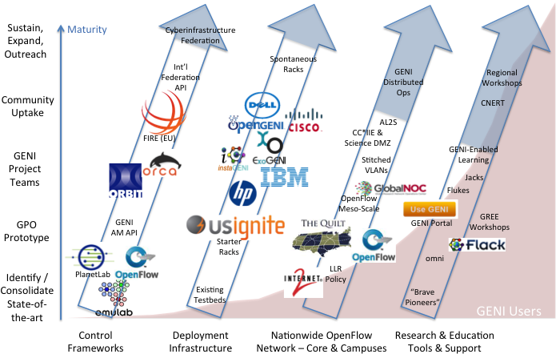
Essential Capabilities of GENI

Slide 27
Where are we now?
GENI has made great strides …
Significant installed hardware base
Software tools for users and developers
Vibrant & thriving user community
Strong, growing academic impact
Leading the way in cyberinfrastructure testbed development and interoperation

Slide 28
GENI as a PAWR Enabler
PAWR Platforms
Easy “On-Boarding” Large User Base
Access to Mature Technologies
Heterogeneous, federated research cyberinfrastructure

Slide 29
PAWR as a GENI Enabler
GENI
Application-Use Case Development
Federation Common API for Wireless, Network,Cloud Resources
Outreach Activities to Align with Industry

Slide 30
What’s in it for You?
Research at-scale |  | Using Highly instrumented end-to-end Platforms to explore wireless, edge and cloud research topics independently or together
Industry Opportunity |  | Critical gap between demand pattern and supply; move away from legacy infrastructure; rapid development, inter-operability
International Scope |  | Federation between US,EU,Asia platforms, shared learning, data and operational best practices

Slide 31
Moving Ahead
A
B
C
G
POWDER-RENEW COSMOS <Your Project Here>

Slide 32
Request For Information
ISSUED April 9 2018
Focus on Applications or Use-Cases providing community benefit
Focus on the transformative wireless technologies needed to enable those applications
Stay Clear of Round I Platform Focus areas
Provide suggestions on process feedback from Round I ( if applicable)
Interested parties are requested to respond to this RFI with a short white paper, to not exceed 2 pages. White papers in PDF format are due no later than Thursday, May 31, 2018, 5:00 PM EDT
https://tinyurl.com/PAWR-RFI-2018

Slide 33



ADVANCEDWIRELESS.ORG
Tommaso Melodia,
Northeastern University
melodia@ece.neu.edu
Abhimanyu (“Manu”) Gosain, Northeastern University
agosain@coe.neu.edu
Kaushik Chowdhury,
Northeastern University
krc@ece.neu.edu
Stefano Basagni,
Northeastern University
basagni@ece.neu.edu

